Slide 1

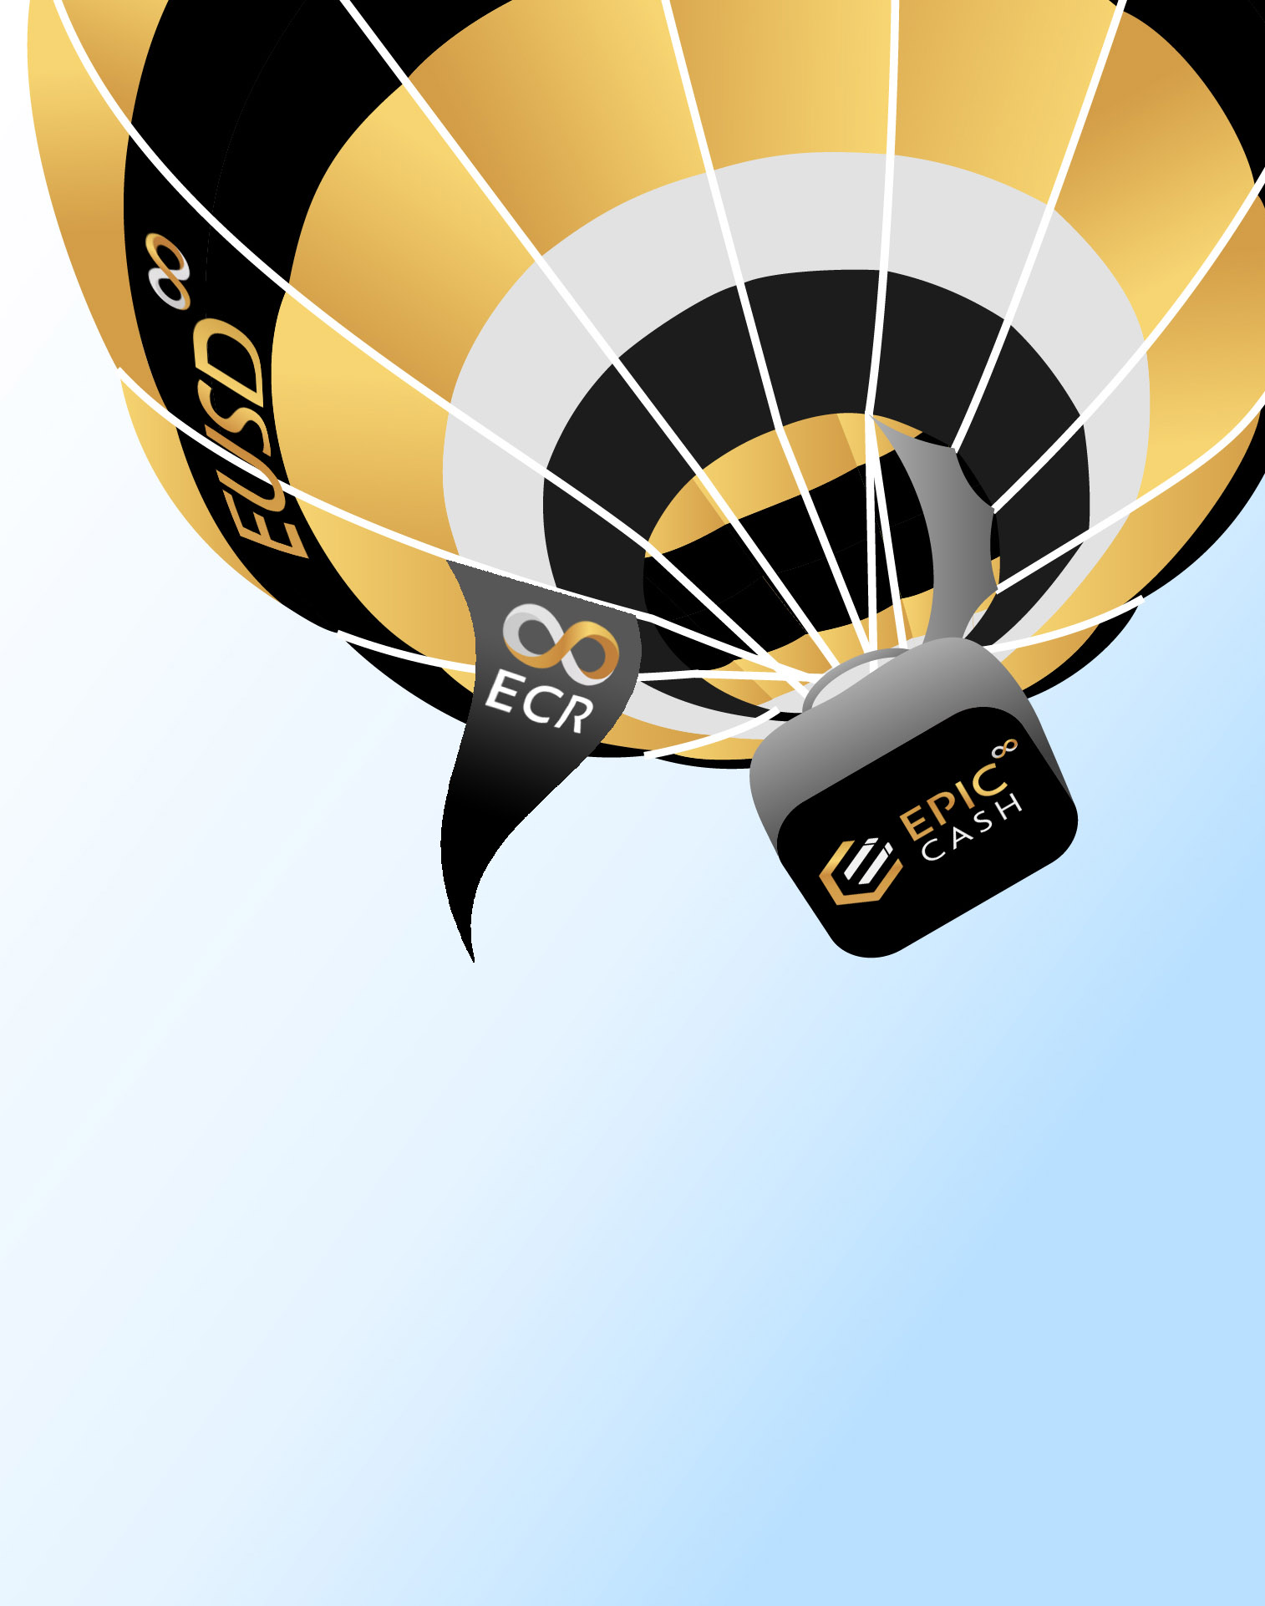
EUSD: A hot air balloon
EPIC: The basket
ECR: The cables that connect EUSD & EPIC
However much hot air fills the balloon determines how big a basket is needed and how strong the cables need to be.

